Slide 1
This Week Work Progress
Lecturer：SUSTech Li Yuchen
2019.2.21

Slide 2
content
01
Reading Code & Recurring paper
02
Mis-Classification analysis
03
Studying machine learning & Tensorflow

Slide 3
Reading paper & Recurring paper
Part One
01

Slide 4
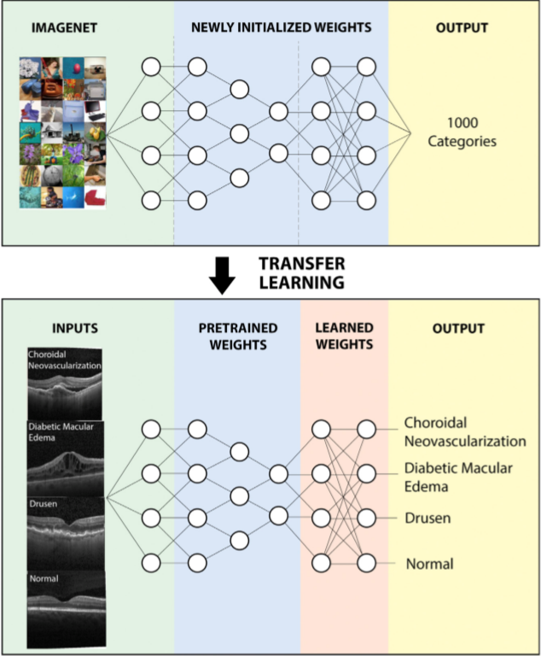
Cell: Identifying Medical Diagnoses and Treatable Diseases by Image-Based Deep Learning

Slide 5
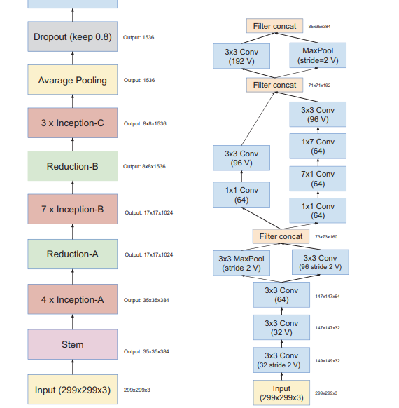
Reading Paper
Inception-v4,Inception-ResNetand the Impact of Residual Connections on Learning
1. Are there any benefits to combining Inception architectures with residual connections?
Application ： object-detection, segmentation, human pose estimation, video classification, object tracking, super-resolution
The dataset comprises of 1.2 million training images, 50,000 validation images and 100,000
test images.
2. combination of two of the most recent ides: Residual connections & the latest revised version of the Inception architecture.

Slide 6
Image Processing
Part Two
02

Slide 7
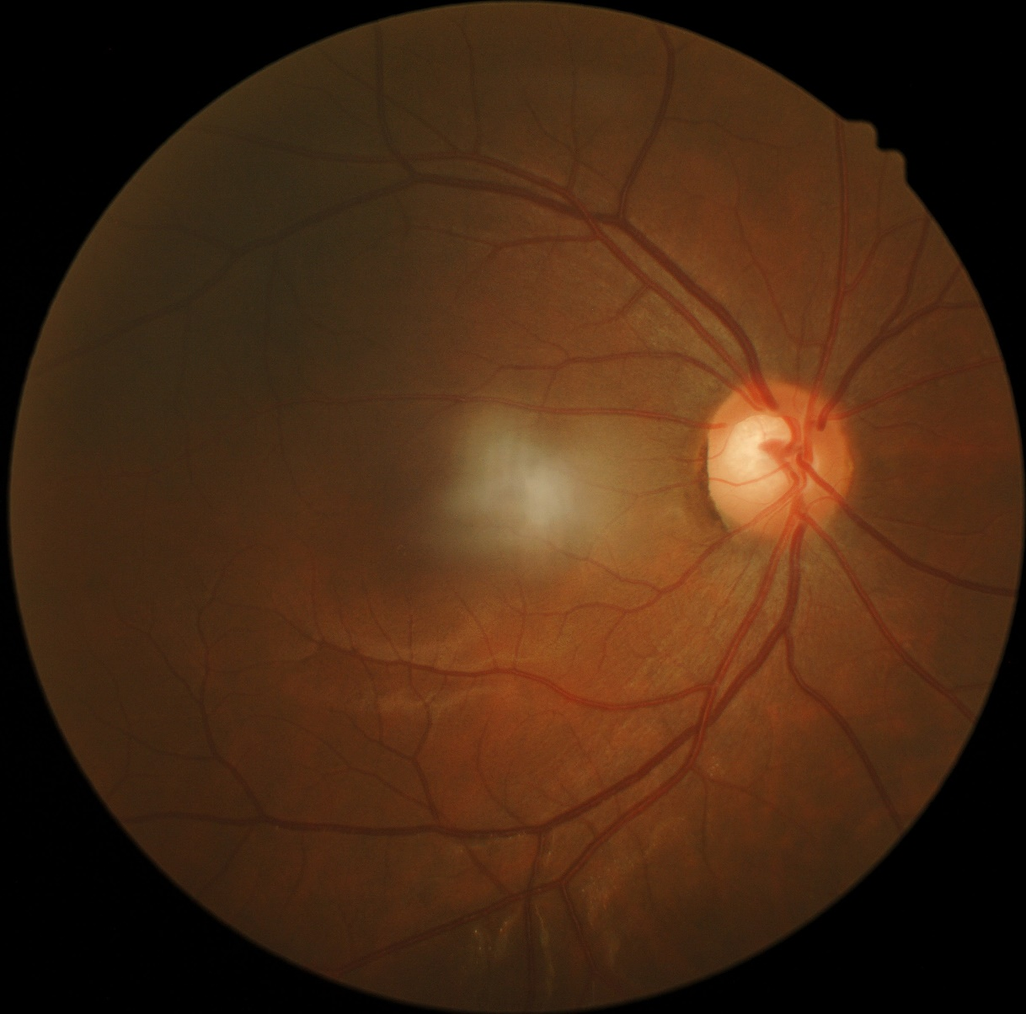
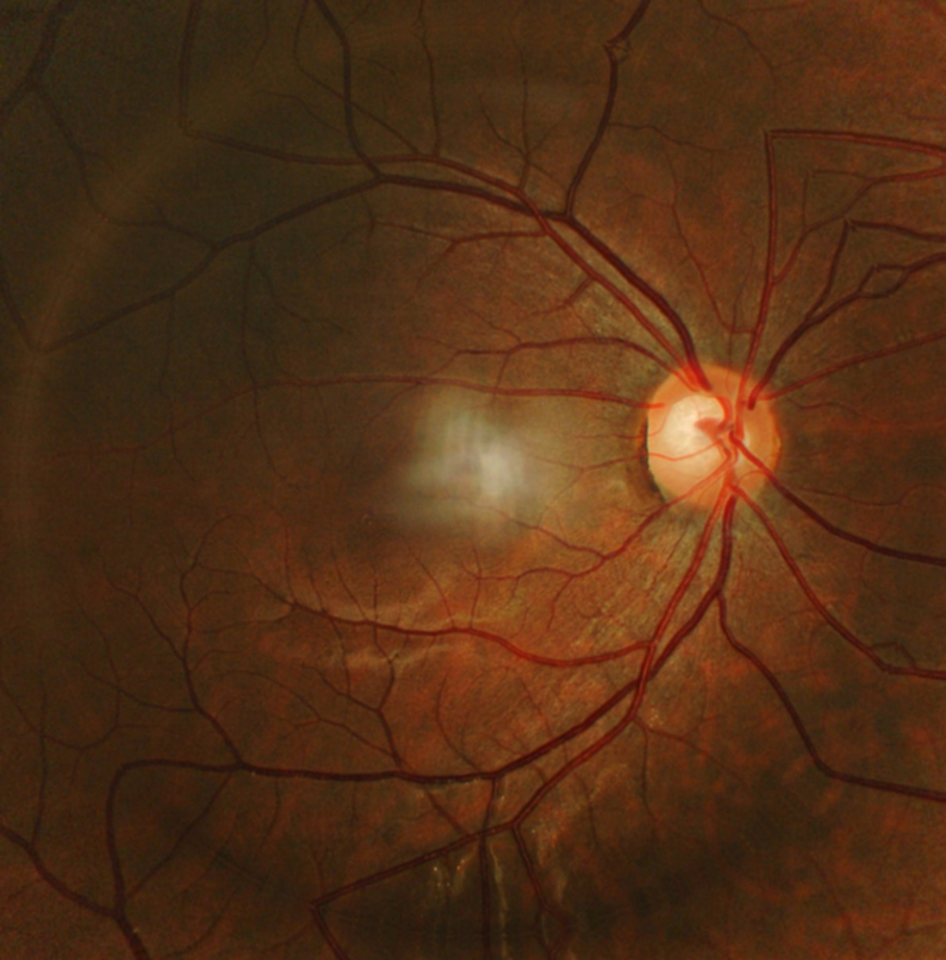
Image Enhancement

Slide 8
Run the Both Dataset
4000、
Best validation accuracy = 88.84353637695312
Final test accuracy = 77.06255912780762
Total Model Runtime: 17min, 35.09sec
8000、
Best validation accuracy = 88.70748281478882
Final test accuracy = 78.60381007194519
Total Model Runtime: 35min, 17.77sec
2000、
Best validation accuracy = 89.79591727256775
Final test accuracy = 77.1078884601593
Total Model Runtime: 94min, 25.98sec

Slide 9
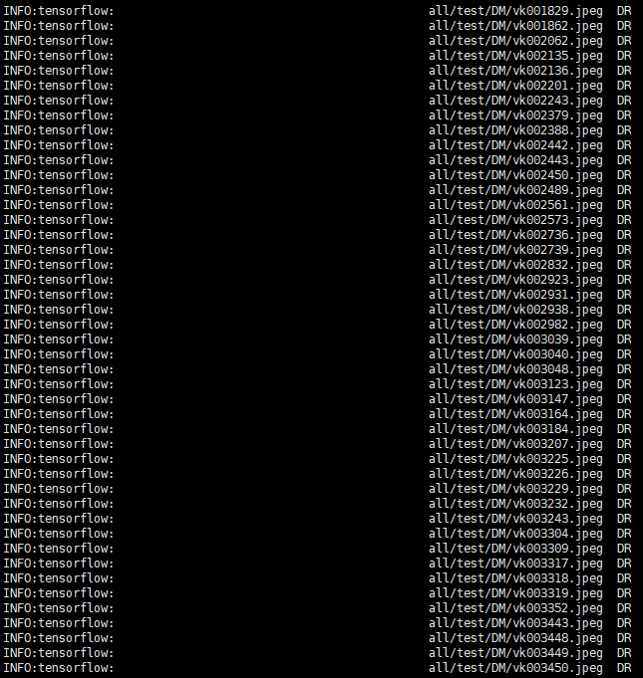
Mis-Classification Analysis
1. Some of the images is too dark (DR->DM)
DR mis-classify to DM: 342 / 525
DM mis-classify to DR: 151 / 1681

Slide 10
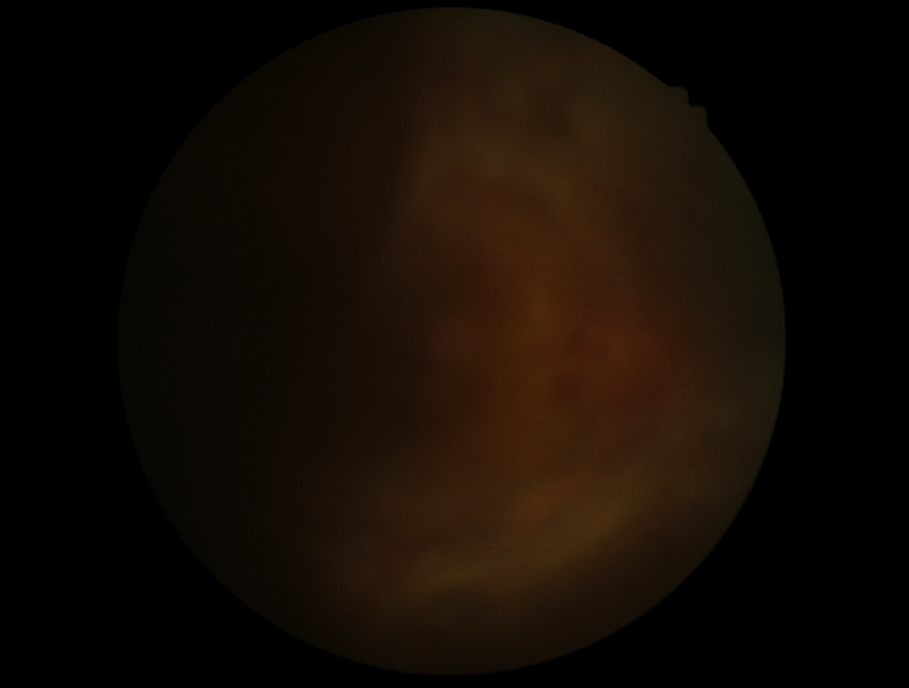
Mis-Classification Analysis
1. Some of the images are too dark (DR->DM)

Slide 11
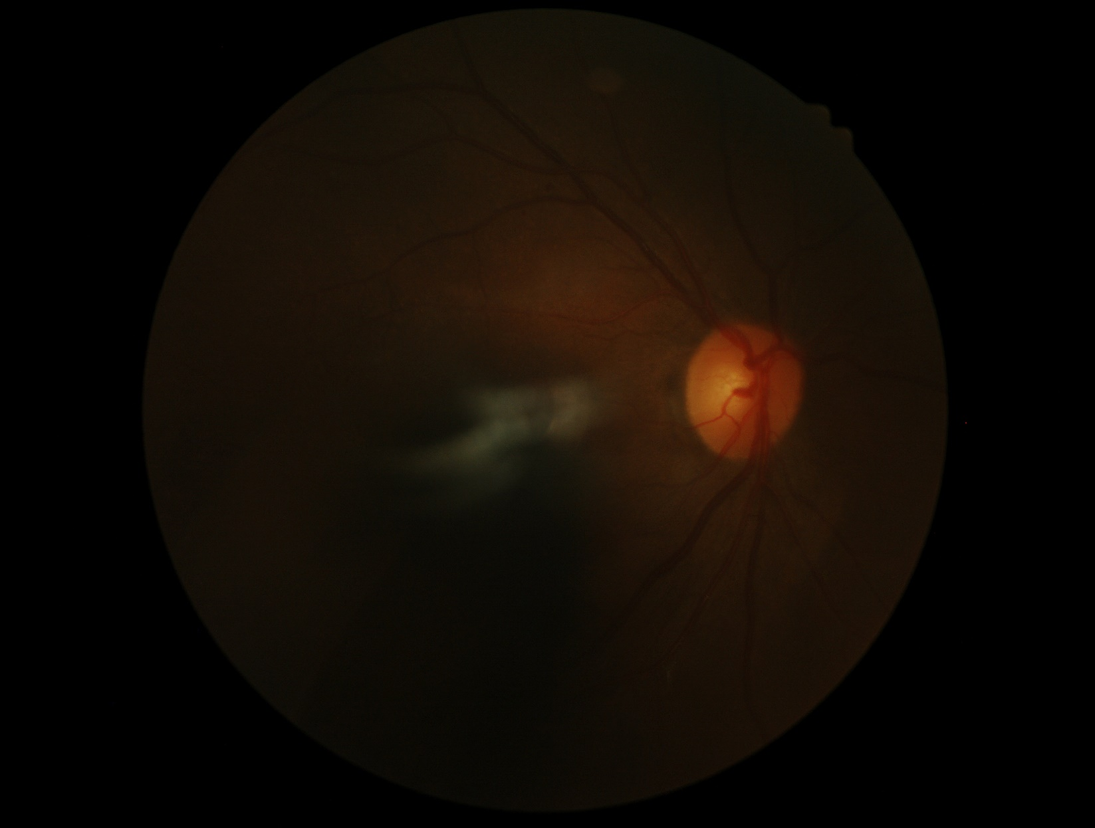
Mis-Classification Analysis
1. Some of the images are too dark (DR->DM)

Slide 12
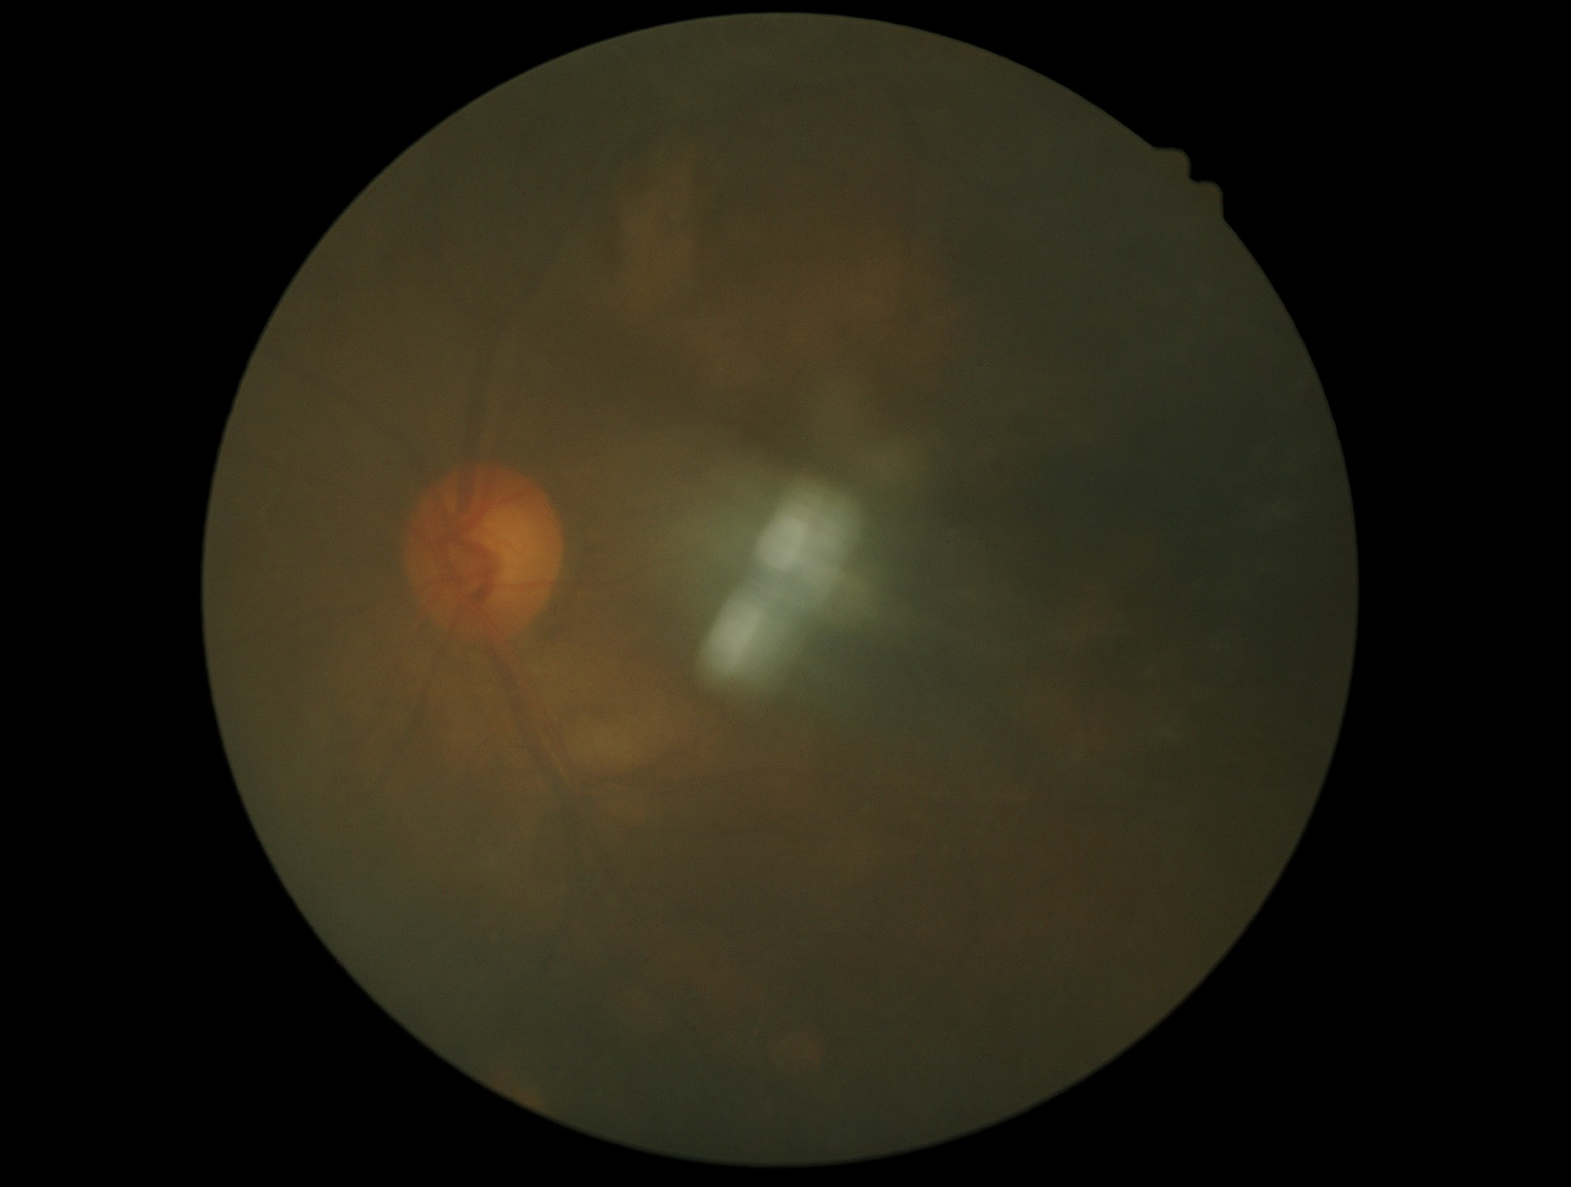
Mis-Classification Analysis
1. Some of the images are too dark (DM->DR)

Slide 13
Mis-Classification Analysis
1. Some of the images are too dark (DM->DR)

Slide 14
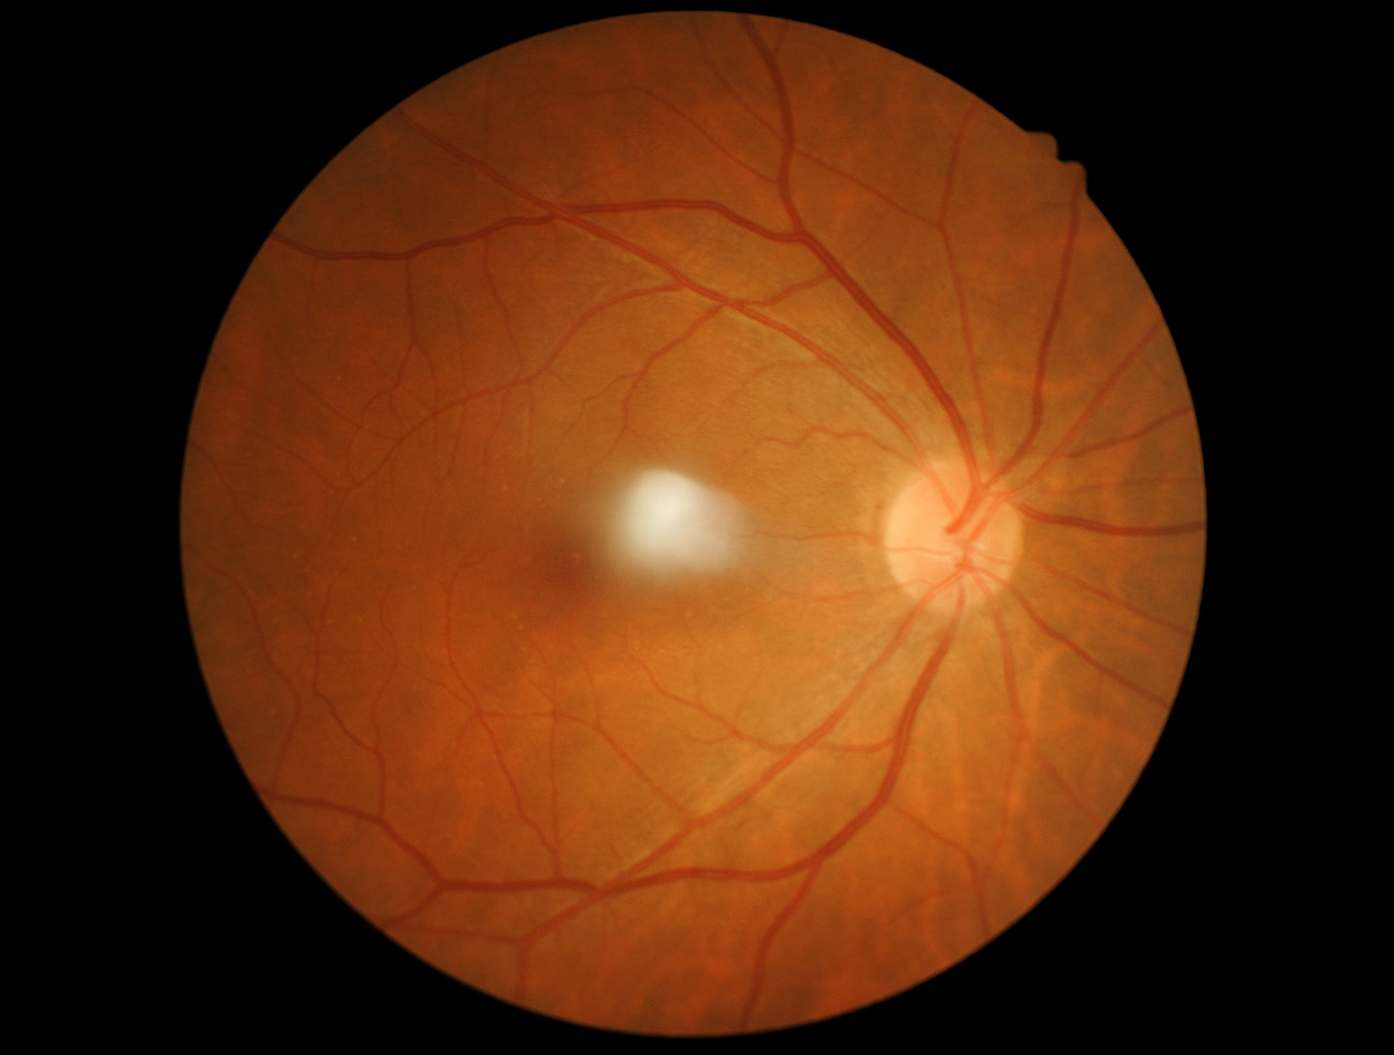
Mis-Classification Analysis
2. Some of the images are few (DM->DR)

Slide 15
Study
Part Three
03

Slide 16
Future plan
01
Analyze the reasons & find questions
02
Try the methods
02
Study

Slide 17
THANKS
And Your Slogan Here.

